Slide 1
http://web.as.uky.edu/Biology/faculty/cooper/STEMCATS-2017/TuesdayStemCats/StemCats-Larval%20development%20and%20behaviors.htm

Slide 2
I was a student back in when dinos roamed the earth.

Slide 3
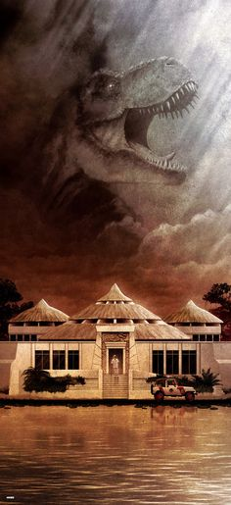

Slide 4
I was a student back in when dinos roamed the earth.
Been teaching undergrads and grads for the past 21 years at Univ. of KY
Use to be chalk board, then over heads, then power point.
- could cover 90 slides and 50 min and students had a copy as well.
Then came movies and web pages (black board and Canvas)
Now one could even post movies of the class material and lots of links.
Students still had the same amount of time to master now 10X more information and they were still expected to know it all.
Now flipped class room and students have to read all material before coming to class to be embarrassed in front of everyone fro not knowing the content.

Slide 7
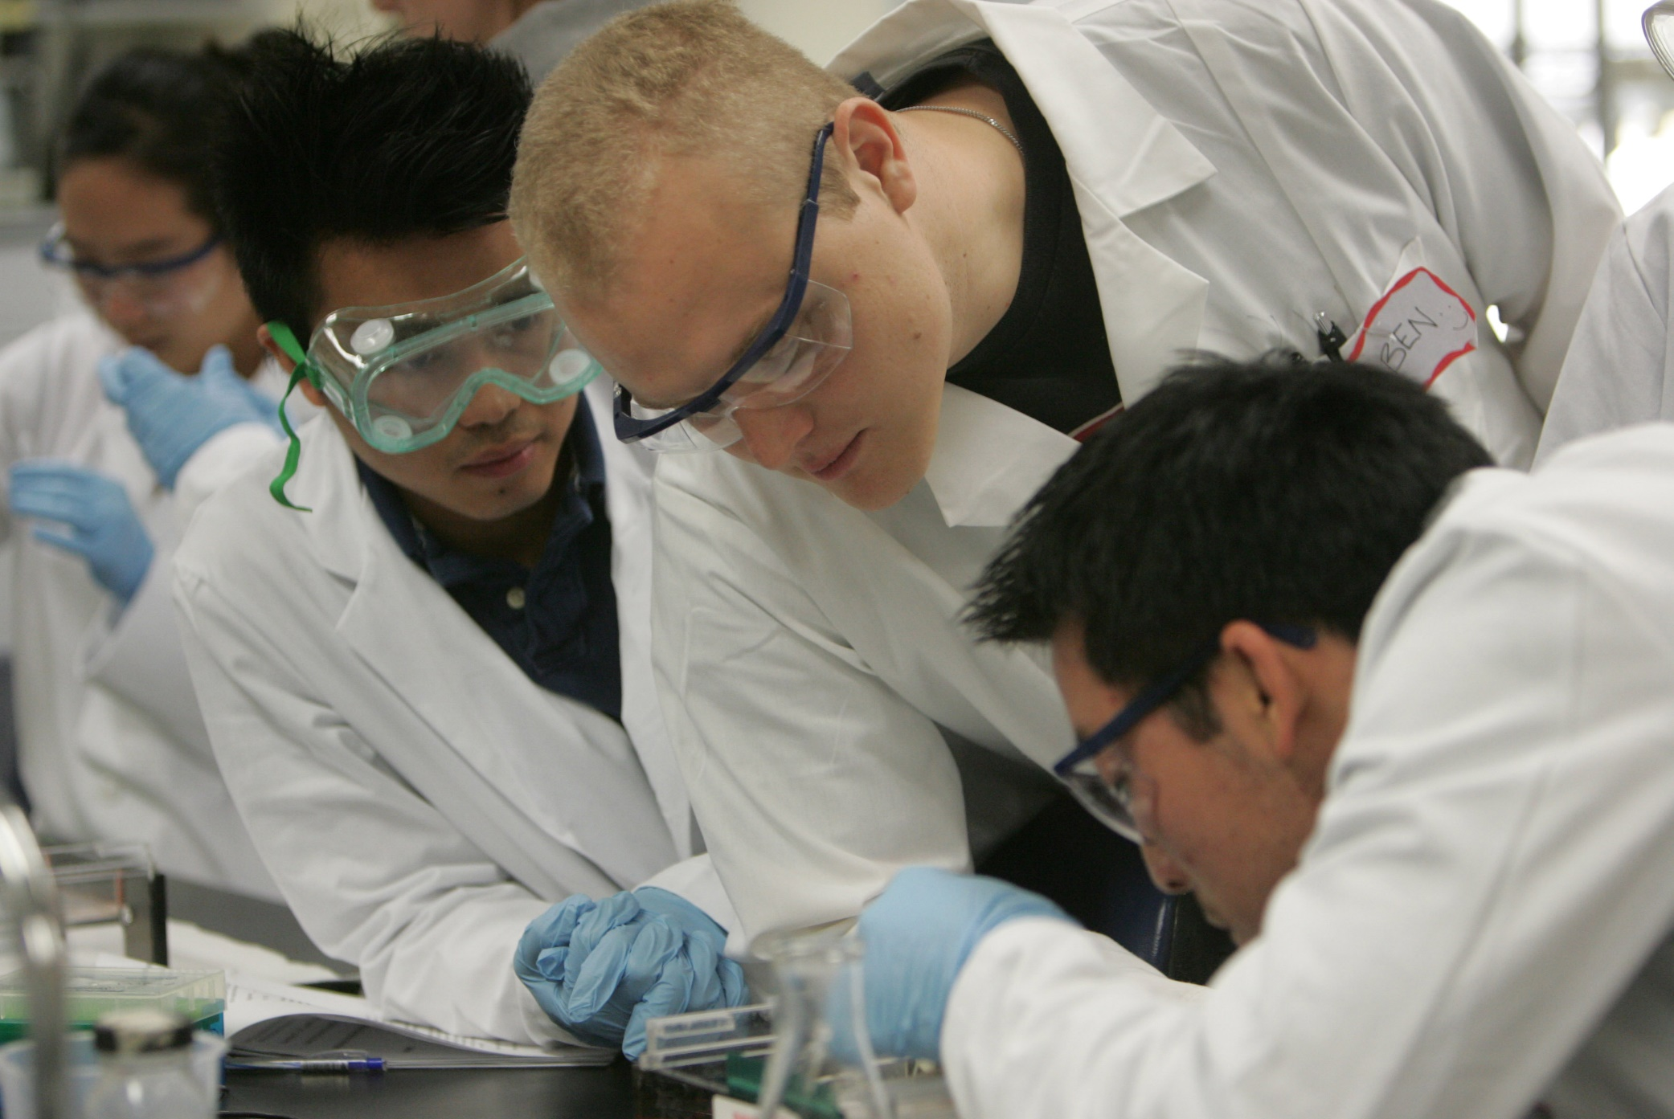

Slide 8
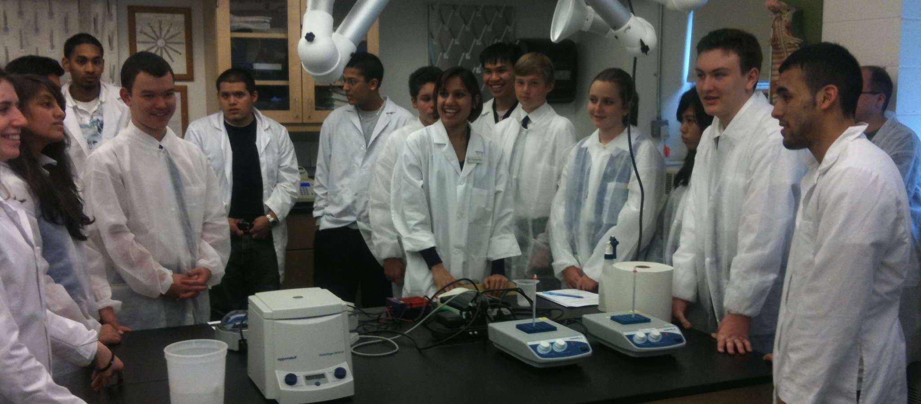
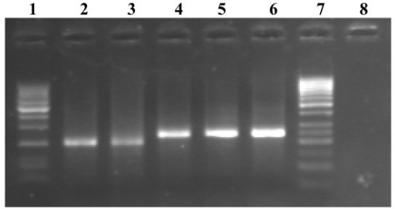

Slide 9
Demonstrations
ACTIVE ENGAGEMENT

Slide 16
Authentic research questions
For a biology class

Slide 17
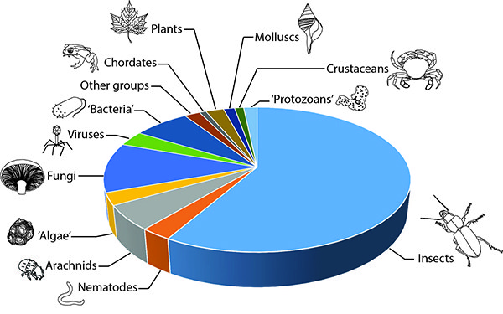

Slide 18
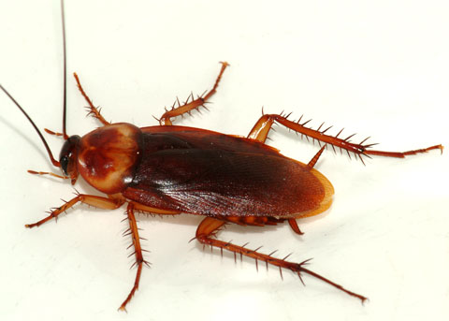

Slide 19
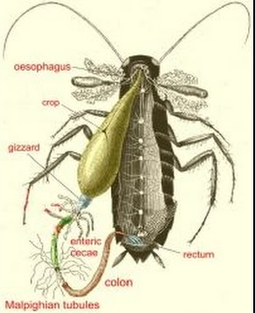

Slide 20
The goals in this project are:
Address authentic physiological research questions for a biology course as a group project for educational purposes
All of a focus at the Drosophila

Slide 21
Informative
Online texts and video clips to understand the basics
Larval developmental studies in cardiac function, growth and innate behaviors
Go over ideas for data analysis while also promoting the discovery based approach of learning.

Slide 22
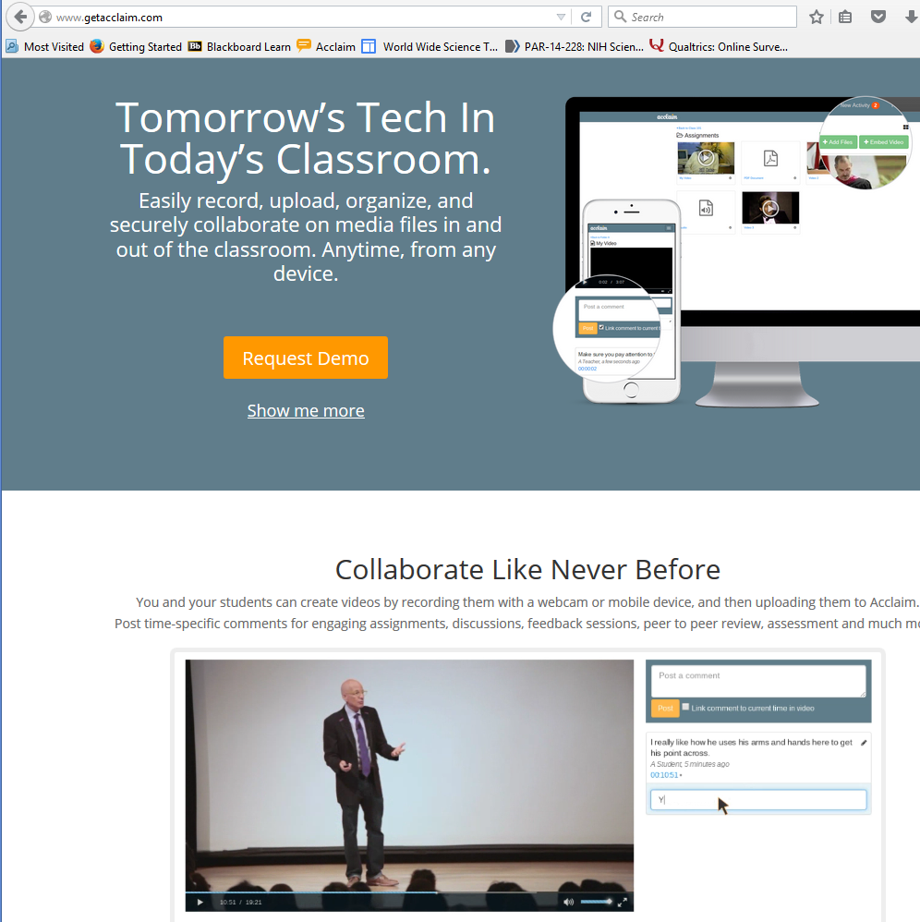
http://www.getacclaim.com/

Slide 25
Undergrads engaging in community outreaching
Public /
Citizen Science
College /
Crowd Sourcing
High Schools
4-8
grades

Slide 26
Lancaster High
jennifer.wilson@pulaski.kyschools.us
Casey Co High
steven.code@casey.kyschools.us

Slide 27
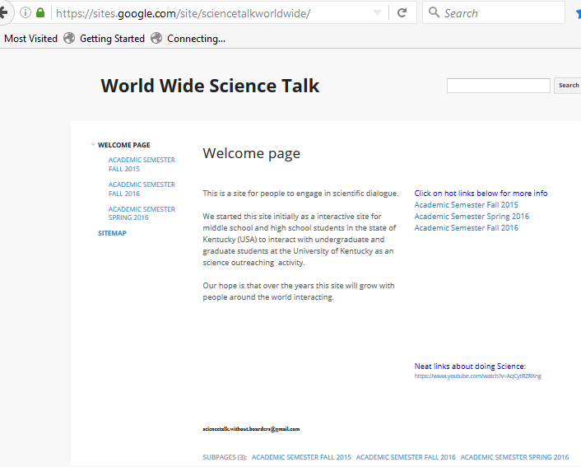

Slide 28
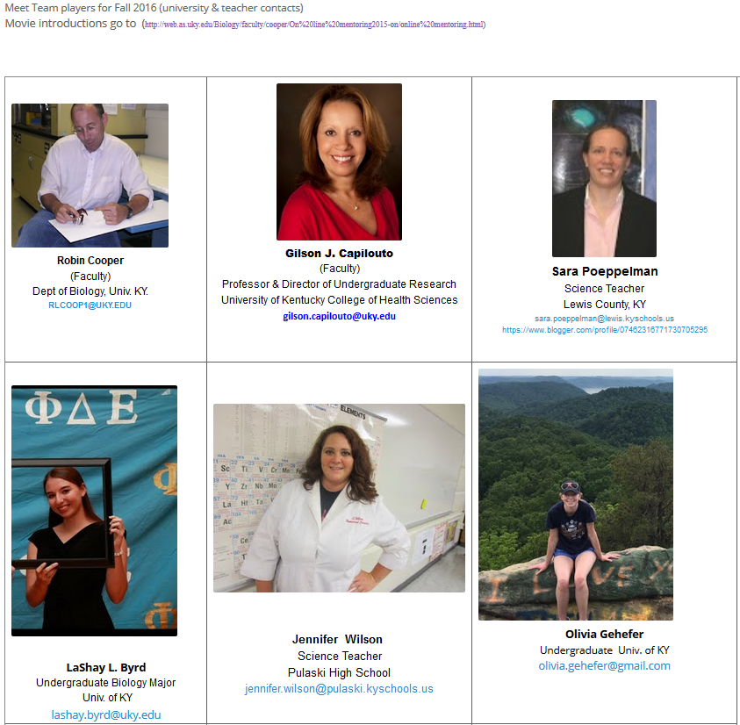
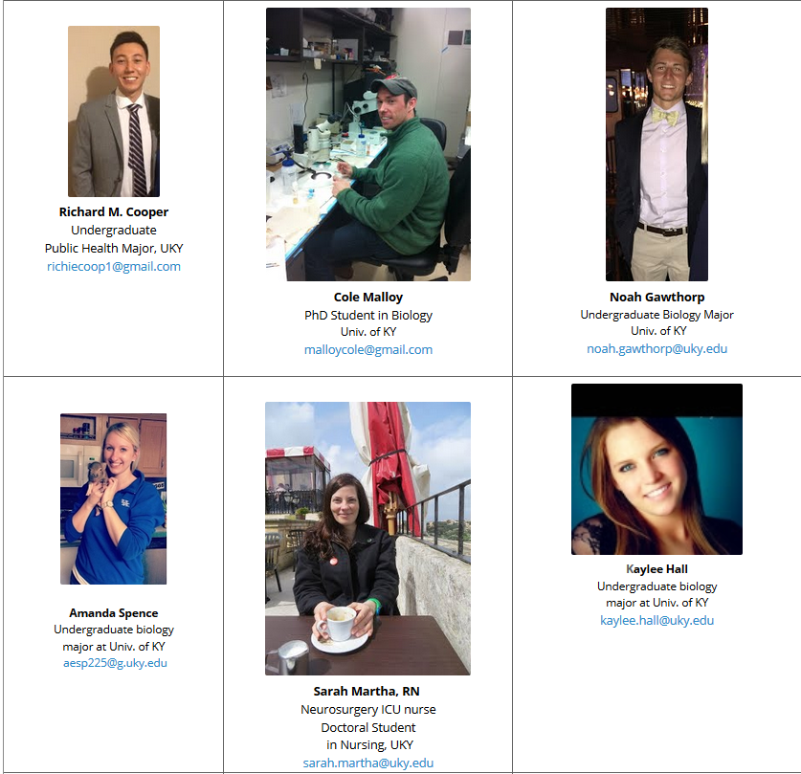
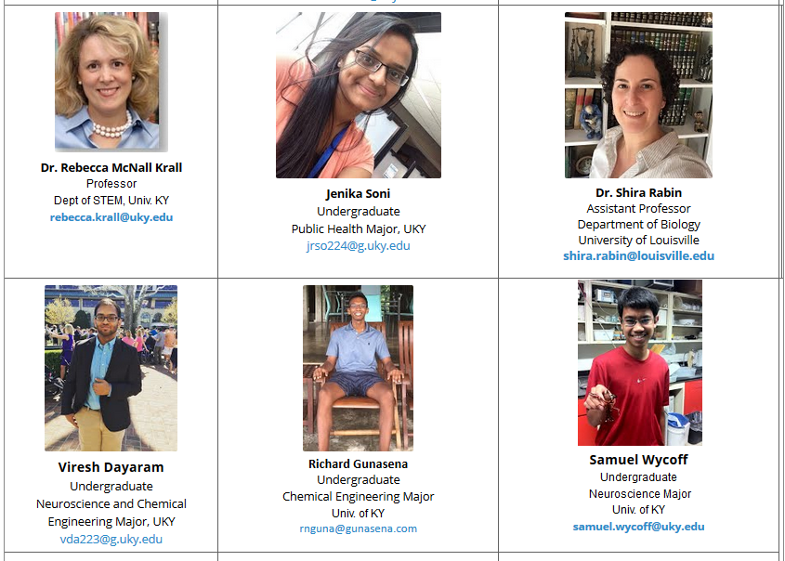
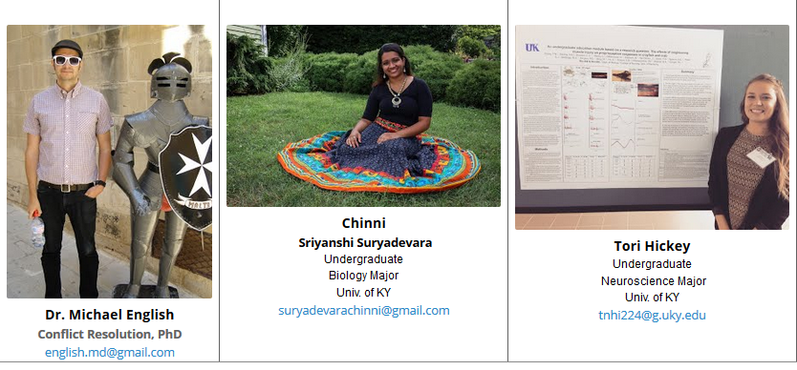

Slide 29
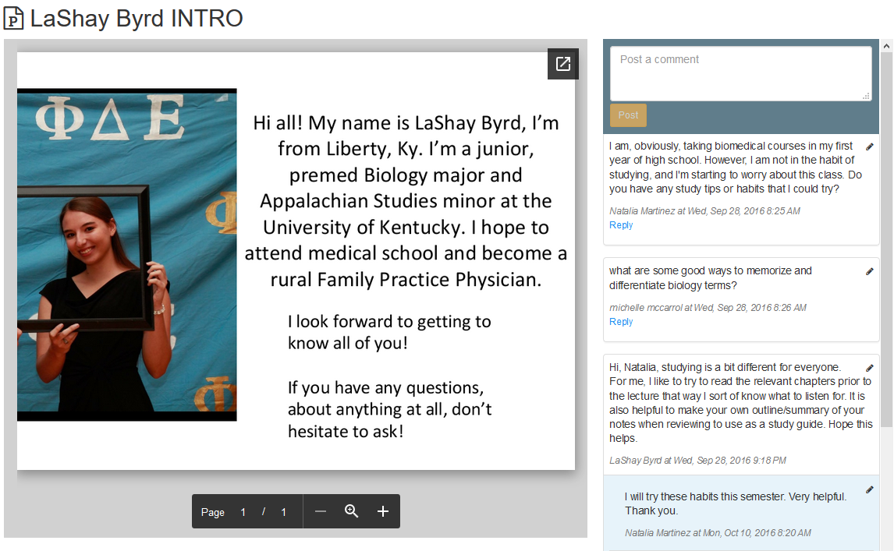
Sample interactions -

Slide 30
Make sure mentors are starting with
the same general content

Slide 31
Student Research
Understanding Metabolic syndrome (web and mentors)
- sub focus is glucose regulation and associated diseases
Physiology, Pathology, treatments such as with insulin types
- class presentations, building types of models (physical or on paper)
to explain glucose regulation

Slide 32
Hands on activities with living organisms
Collect data, graph data, interpret data, discuss the results

Slide 33
Project 1: "Larval development” bad to good, good to bad diets.
General activity:
The idea is to slow down development with poor diet then test an enriched diet.
PROJECT 2: Controlled diets (high fat, high protein, high sugar)
This experiment focuses on the effect of larval development with varying concentrations of nutrition namely glucose, fructose, peptones and coconut oil.
For the control, the basic media was supplemented with cornmeal.

Slide 34
Aim
To estimate the duration of survival and the stages of development of larvae within a fixed time frame in varying concentrations of the following mediums:
-Fructose
-Glucose
-Peptones
-Coconut oil (for fat)
-Cornmeal

Slide 35
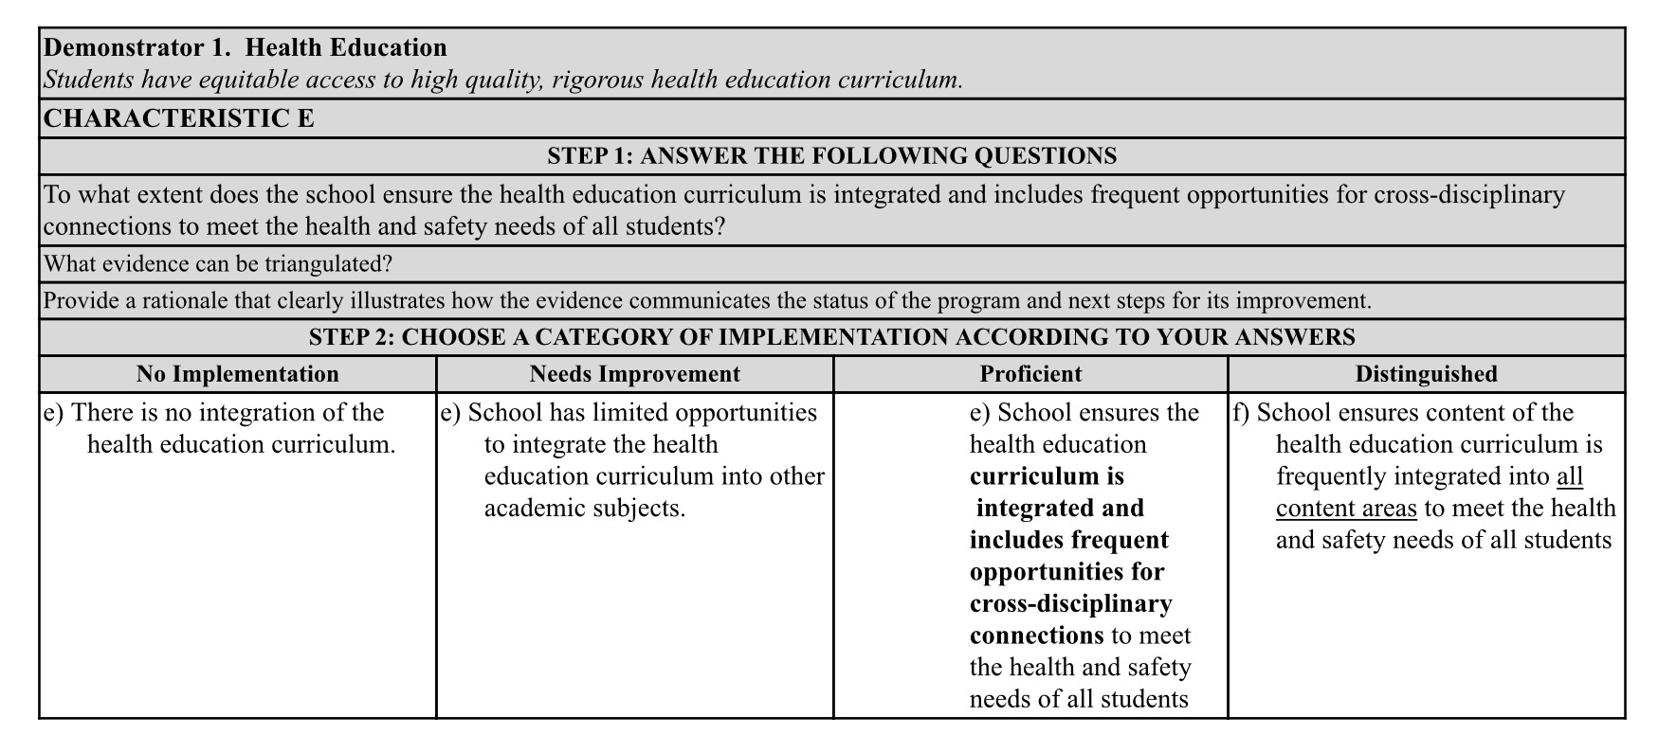

Slide 36
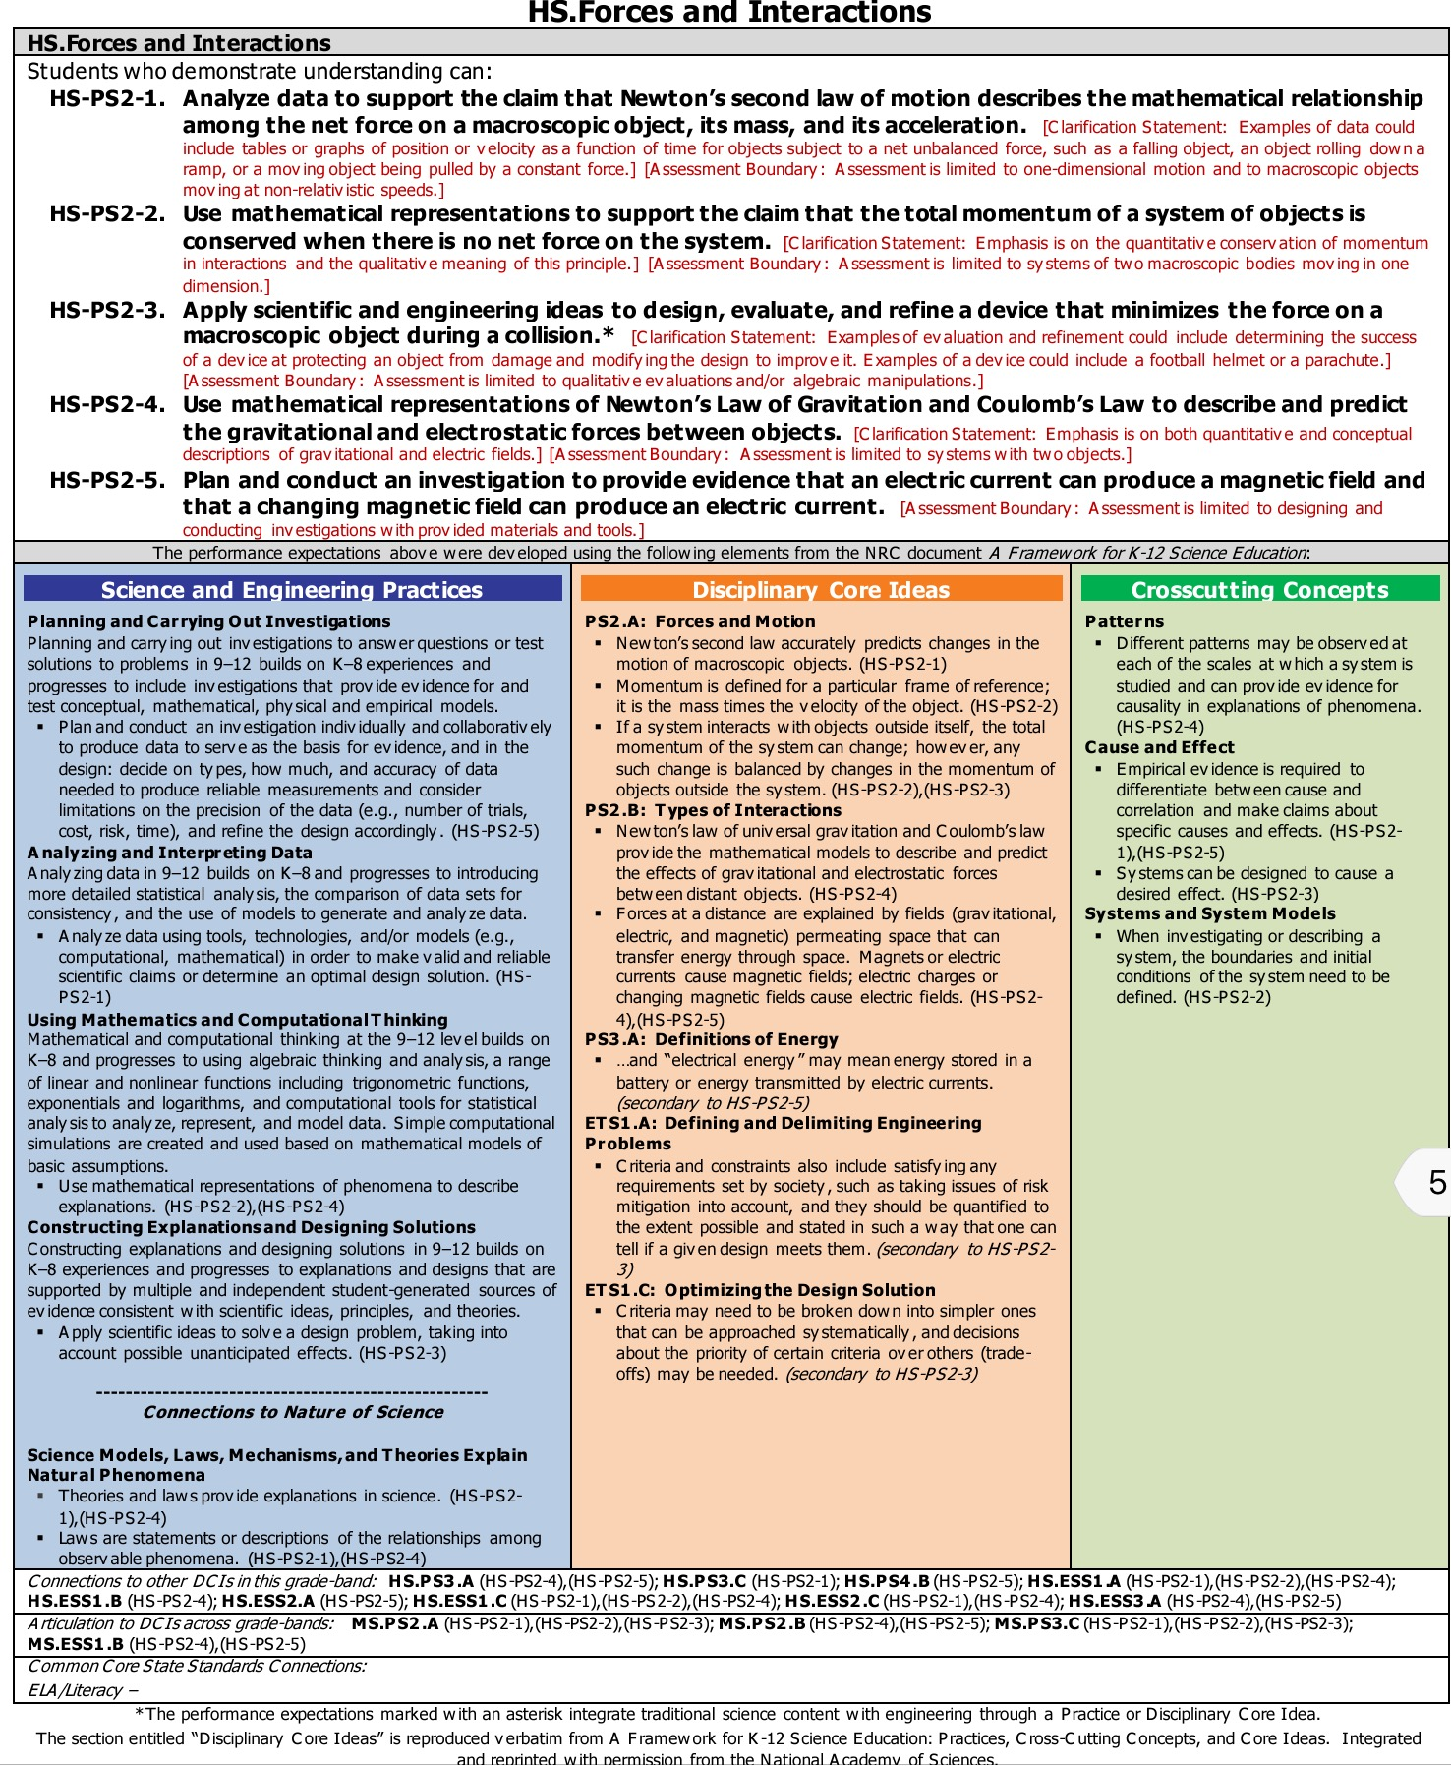
NGSS

Slide 37
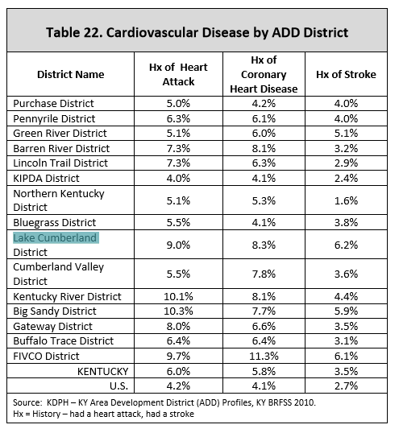
Students Begin Analysis of Health Data to Determine Problems and Issues

Slide 39
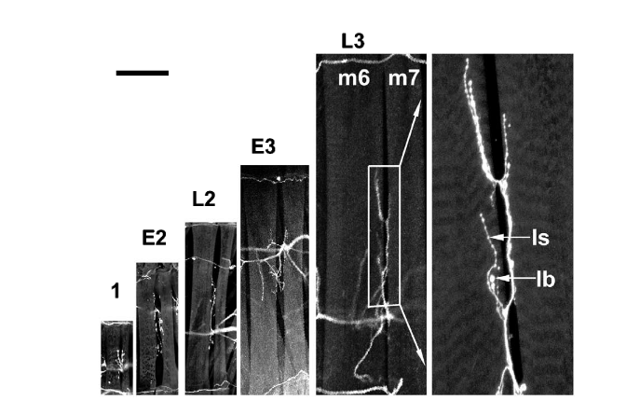
Li, H. , Peng, X., and Cooper, R.L. (2002) Neuroscience 115:505-513

Slide 40
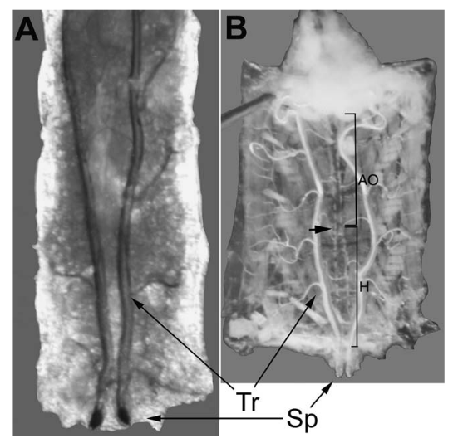
Dasari, S. and Cooper, R.L. (2006) Journal of Comparative Physiology B 176: 349–357.

Slide 41
http://www.jove.com/video/1596/monitoring-heart-function-larval-drosophila-melanogaster-for
1:56

Slide 42
Skeletal muscle growth

Slide 43
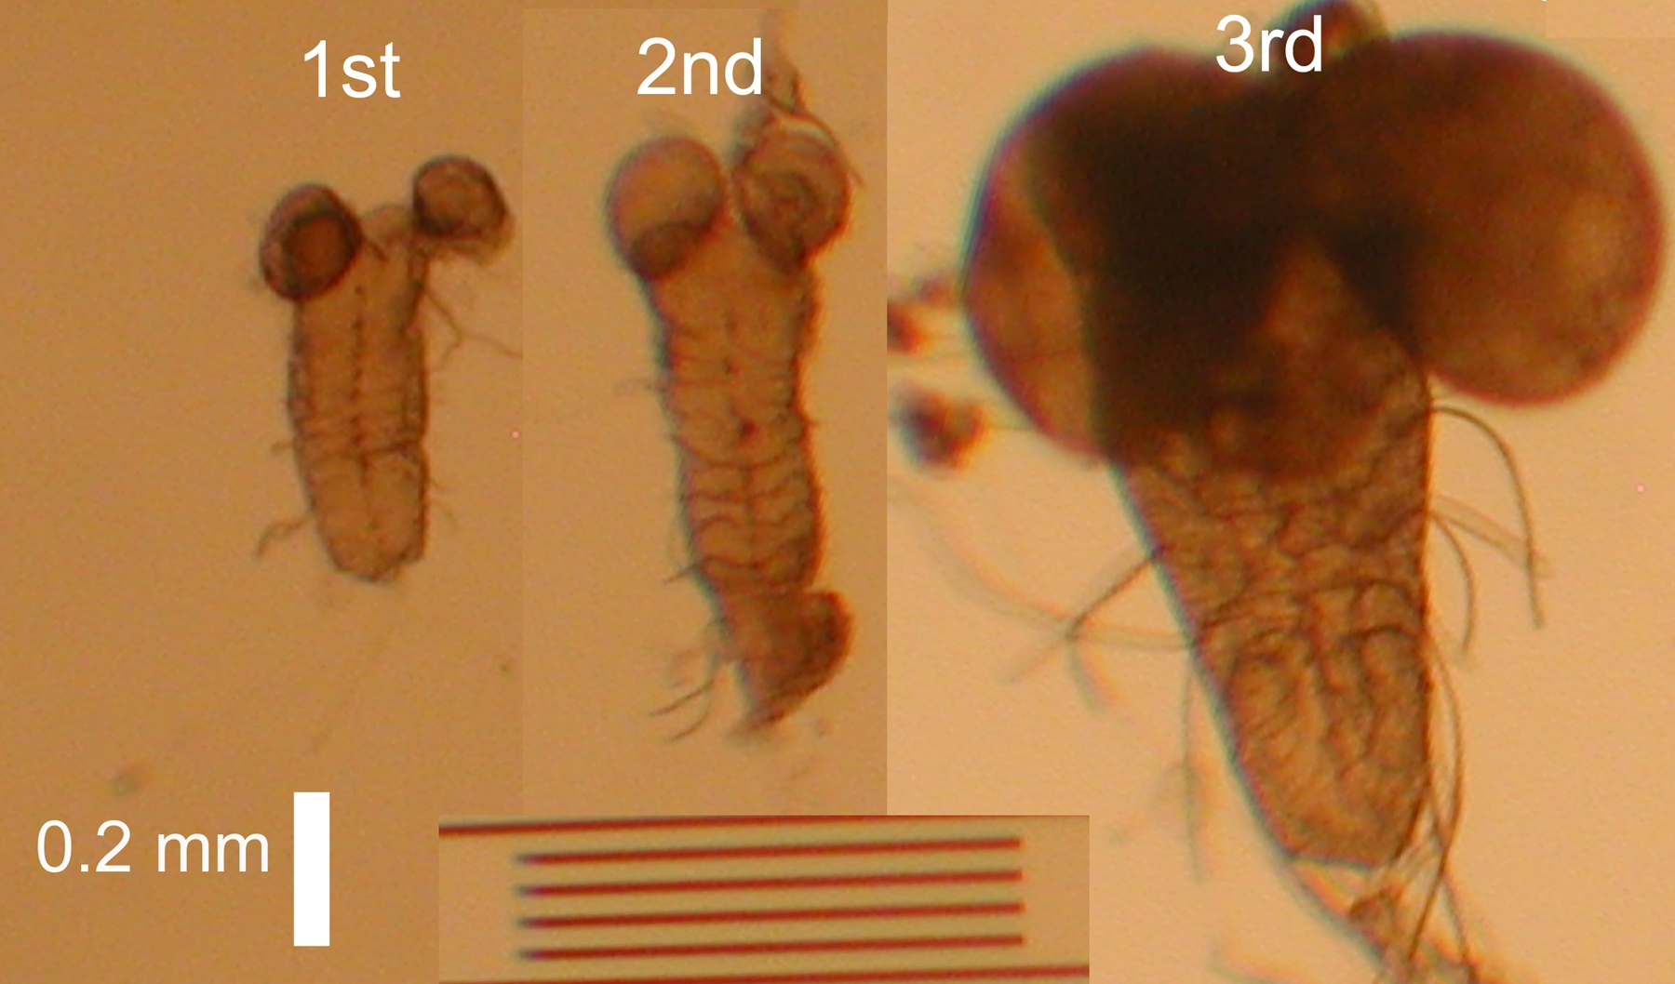
Brain Development

Slide 44
The dramatic increase in muscle mass observed during Drosophila larval development provides a sensitive setup for the identification of evolutionarily conserved genes regulating muscle mass. (Piccirillo et al., 2014)
Skeletal muscle accounts for approximately 40%–50% of the body mass in humans. Maintenance of muscle mass and strength through proper nutrition and exercise is critical to maintain full activity, prevent obesity and decrease the risk of heart disease, diabetes, and cancer (Pate et al., 1995).
Similar observations have been made in Drosophila where muscles account for 40 to 50% of the body mass, and
muscle growth depends on nutrient supply sensed via the Insulin/Akt/TOR pathway (as in mammals).
(Piccirillo et al., 2014)
Knowledge gained from studies in Drosophila should help define the nature of muscle-nerve
interactions, which are presumably related to the mechanisms functioning in mammalian
adult differentiated muscles.

Slide 45
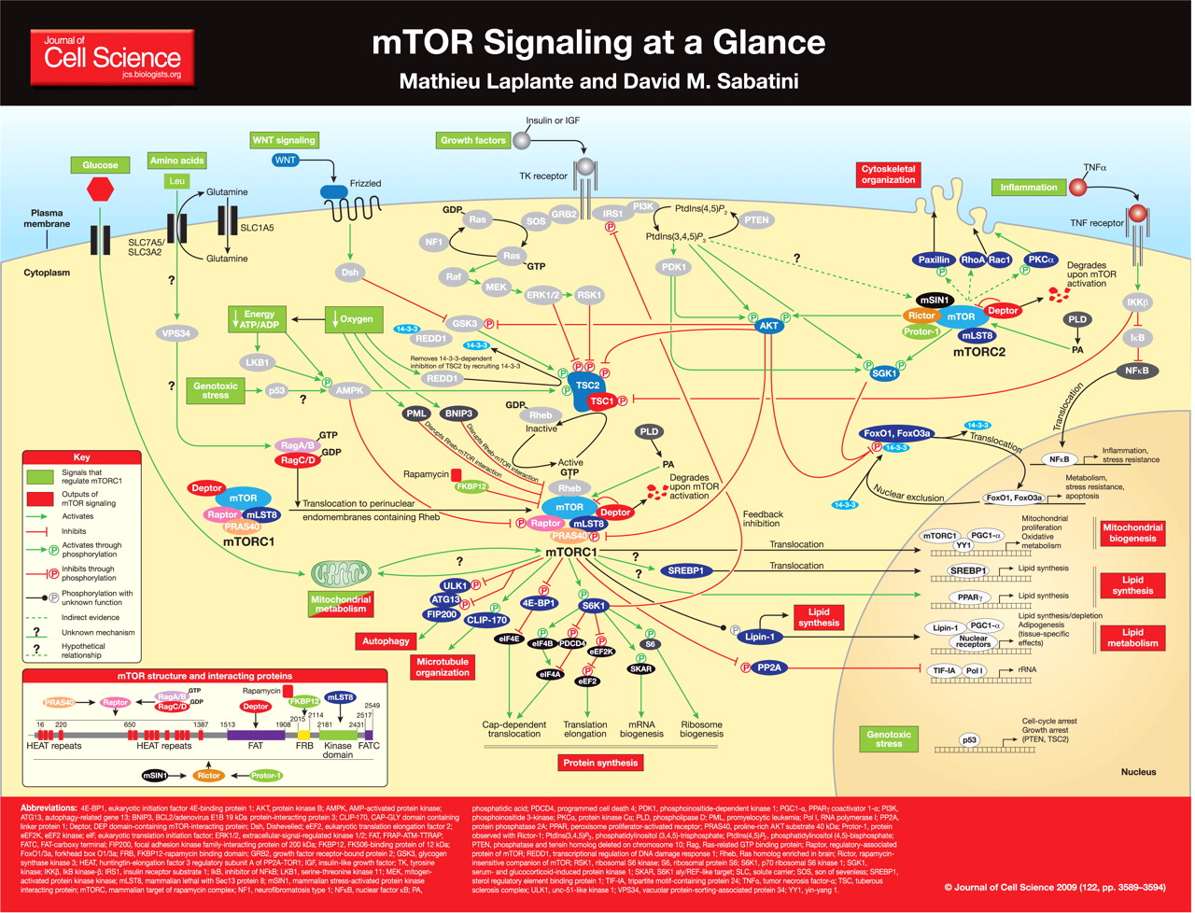
Sugar

Slide 46
Fruit fly model
Regulating growth and division is an important feature of all cells, both within unicellular and multicellular organisms
Same basic cellular needs: Ion channels, enzymes, lipid membrane, steroid based hormones, amino acids, sugar
Essential nutrients ….. What happens with altered diets (limited to sufficient to excess) (excess to limited)
Disease model - ~50 or so diseases now modeled in Drosophila.
Educational model for high school and college level courses as well as primary basic and applied research.
(pharmaceutical screening, genetic manipulations)
One focus we are modeling and building educational content around is the disease of Metabolic Syndrome

Slide 47
Metabolic Syndrome
NIH term:
http://www.nhlbi.nih.gov/health/health-topics/topics/ms
Metabolic syndrome is the name for a group of risk factors that raises your risk for heart disease and other health problems, such as diabetes and stroke.
Metabolic Risk Factors
The five conditions described below are metabolic risk factors. You can have any one of these risk factors by itself, but they tend to occur together. You must have at least three metabolic risk factors to be diagnosed with metabolic syndrome.
A large waistline
A high triglyceride level
A low HDL cholesterol level
High blood pressure
5. High fasting blood sugar

Slide 48
Aim:
To estimate the duration of survival and the stages of development of larvae within a fixed time frame in varying concentrations of the following mediums:
- Fructose
- Glucose
- Peptones
- Coconut oil (for fat)
- Cornmeal

Slide 49
The experiments are being conducted in trails with mixing of the various foods or pure diets (fructose, protein, lipids)
Medium containing 10g of glucose, 4g of yeast, 1.25 g of agar, 0.4ml of propionic acid and 100 ml of water was used (reference source).
A fructose medium was created with 10g of fructose instead of glucose.
Likewise peptone or lipid (Coconut oil) can be substituted.
Measures:
Larval survival
Time to pupation
Behaviors (body wall contraction and mouth hook movements)

Slide 50
Intracellular muscle
recording

Slide 51
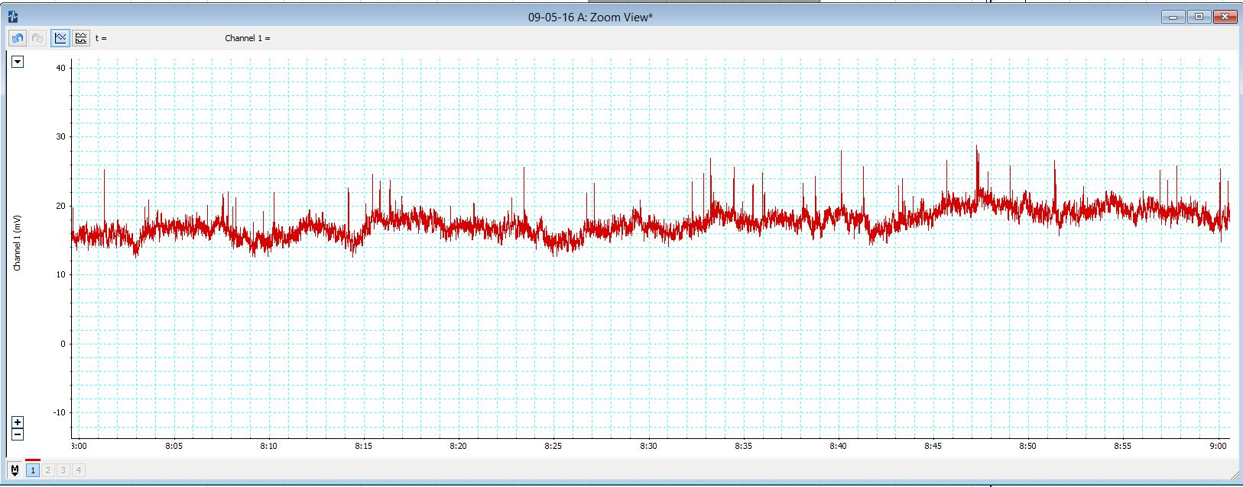

Slide 52
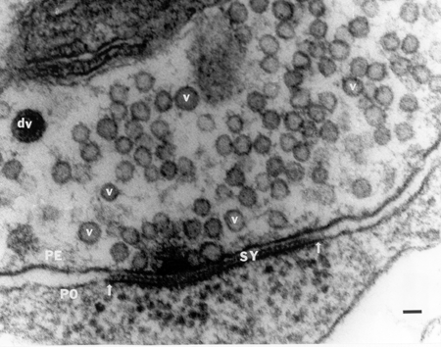

Slide 53
Ca²⁺
Ca²⁺
Ca²⁺
Ca²⁺
Ca²⁺

Slide 54
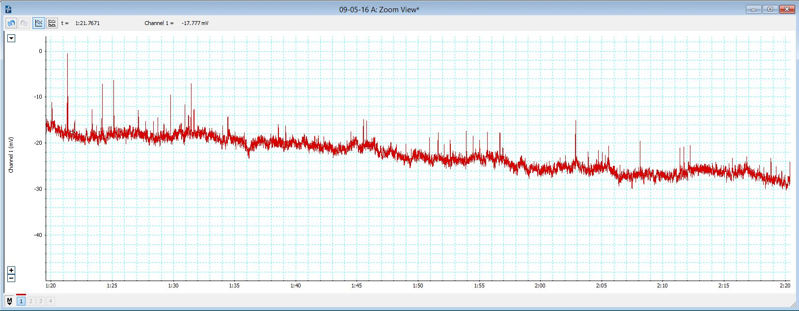
1 mM Ca²⁺
3 mM Ca²⁺

Slide 55
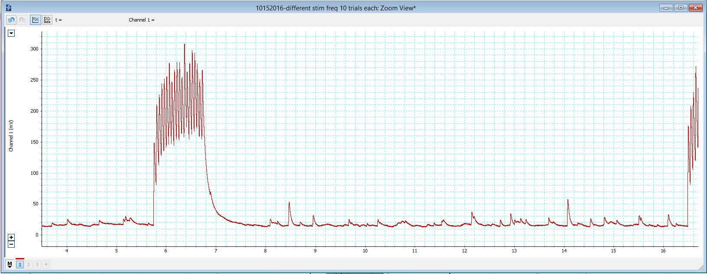
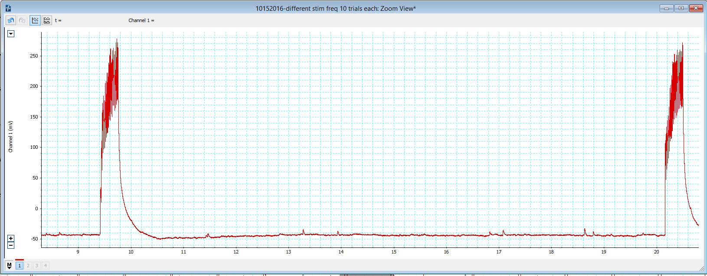
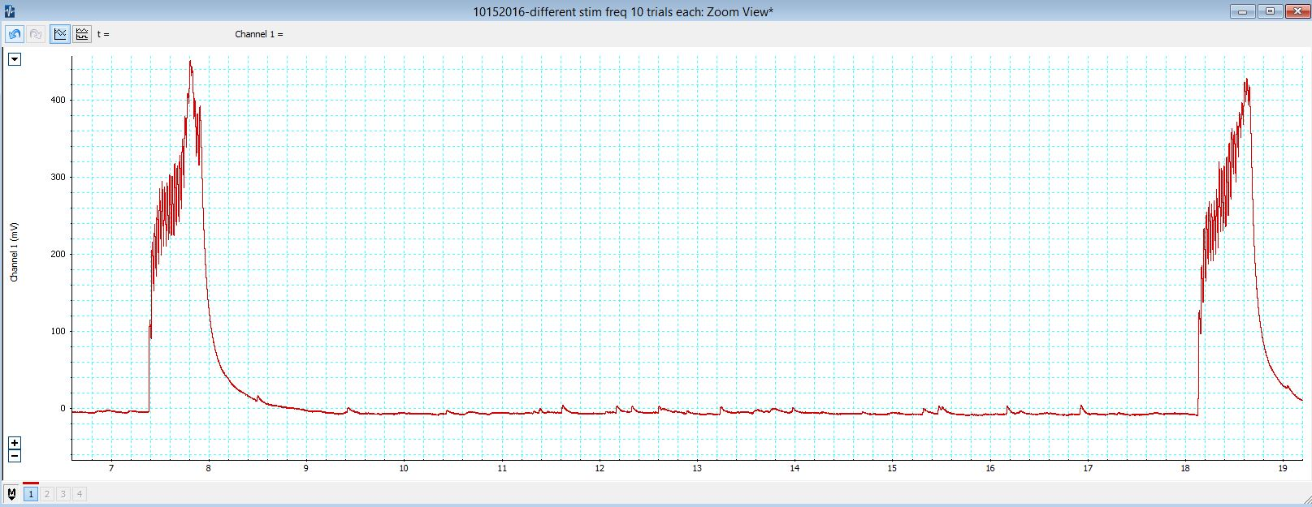
- The effect of stimulation trains on the subsequent rate of
spontaneous vesicle fusion events; and
20 pulses at 20 Hz
20 pulses at 60 Hz
20 pulses at 40 Hz

Slide 56
Tables or growth curves etc…
Survival etc..

Slide 57
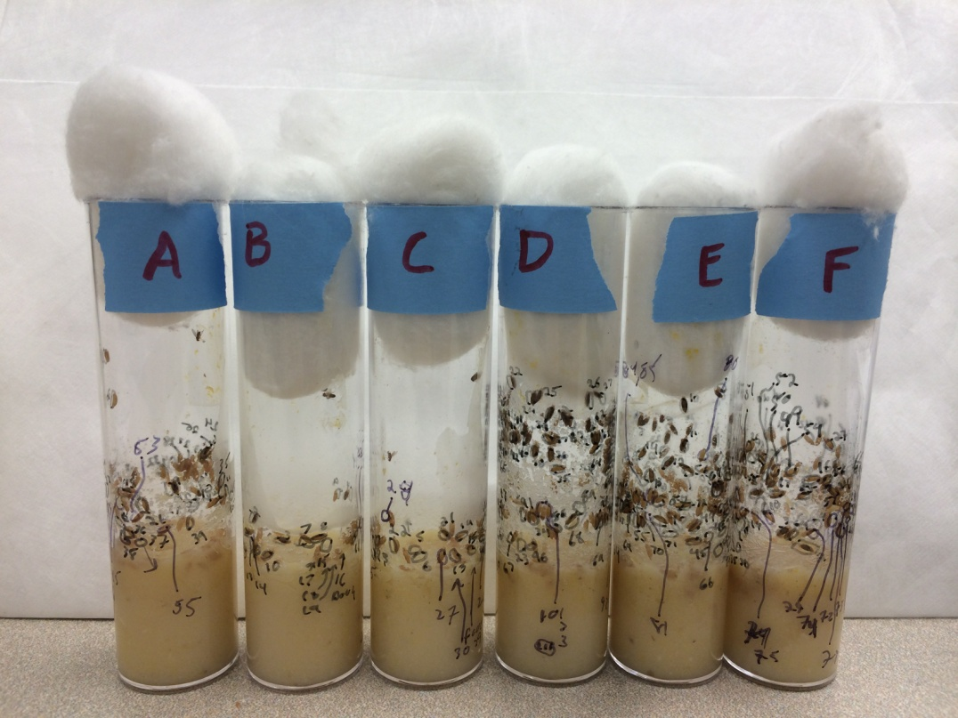
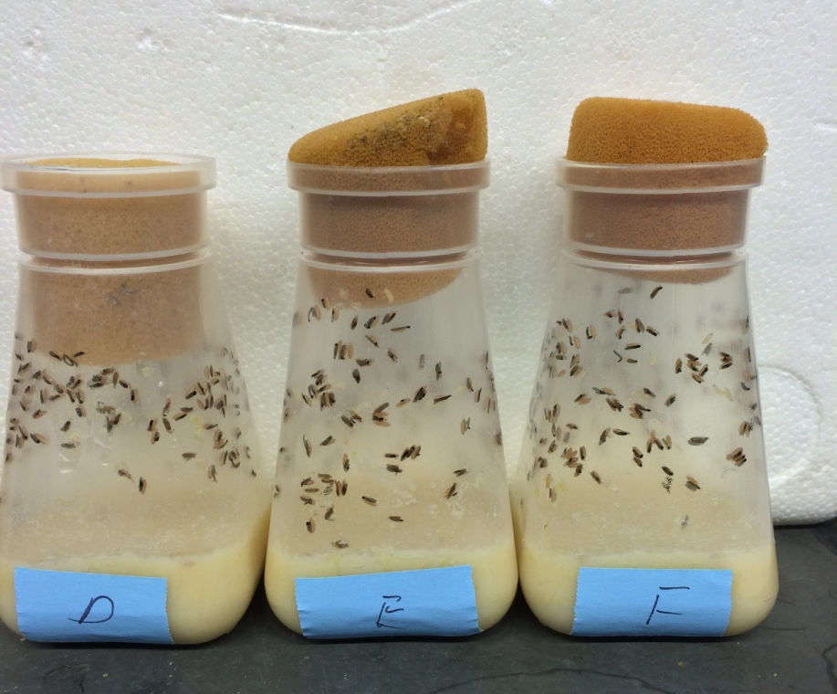
Rate of population growth depending on diet

Slide 58
Pupa and adult behaviors in response to diet as a larvae .
Time to pupation and then the time for the pupa to become an adult with larvae raised on 2, 4 or 6 days on sugar water before being placed in corn meal.

Slide 59
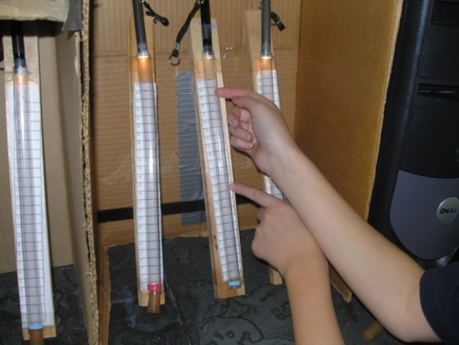
The adult test with light responses with larvae fed sugar water for various days.

Slide 60
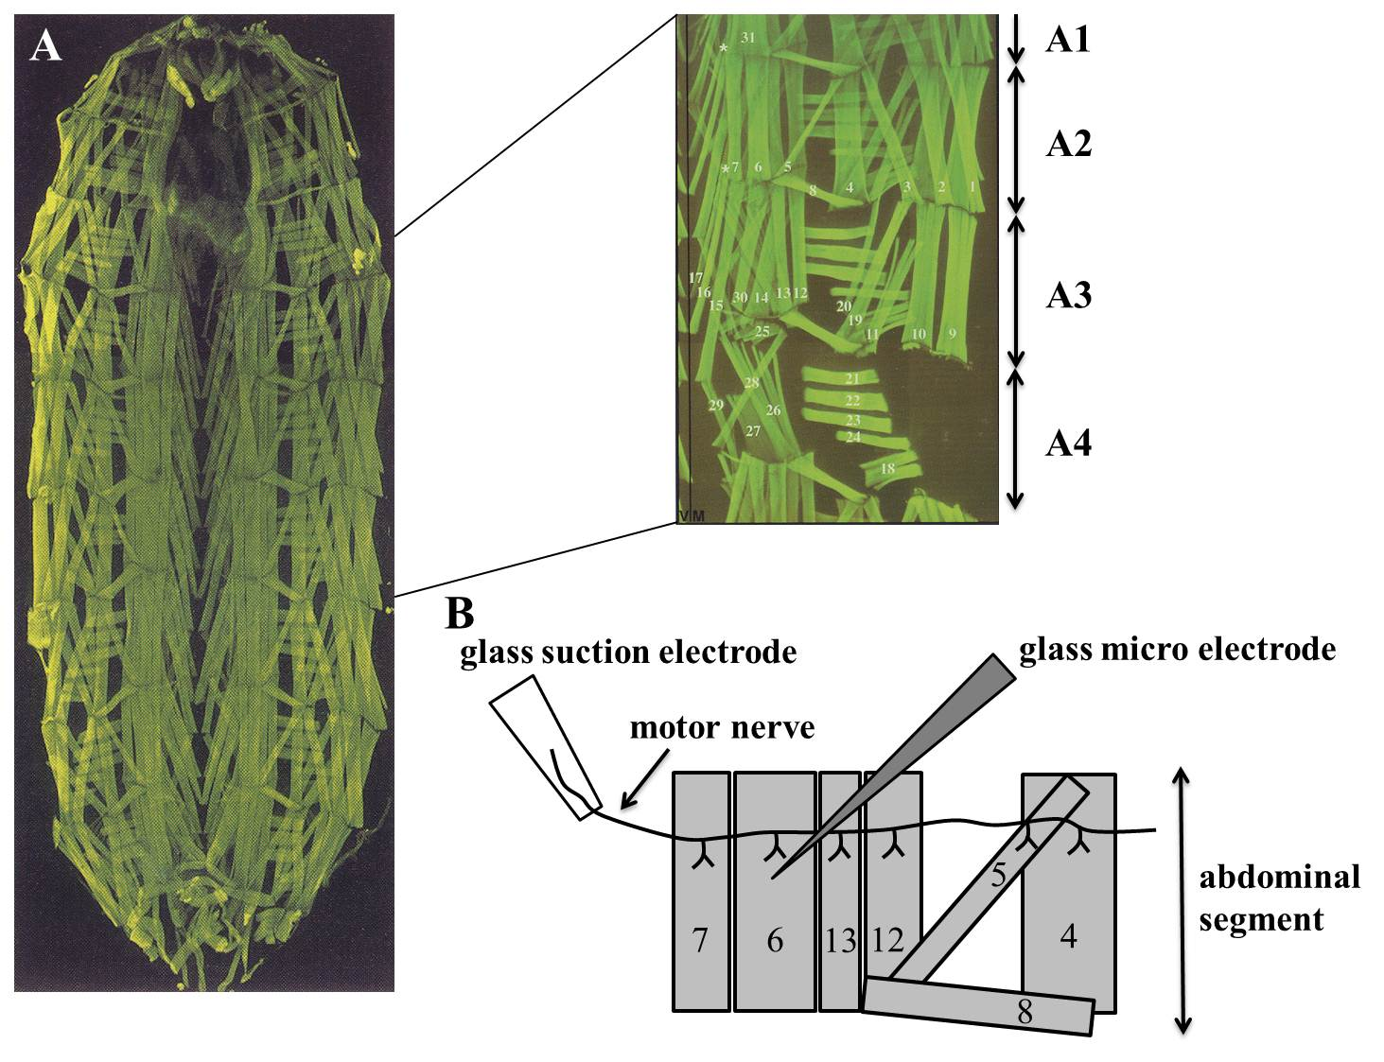

Slide 61
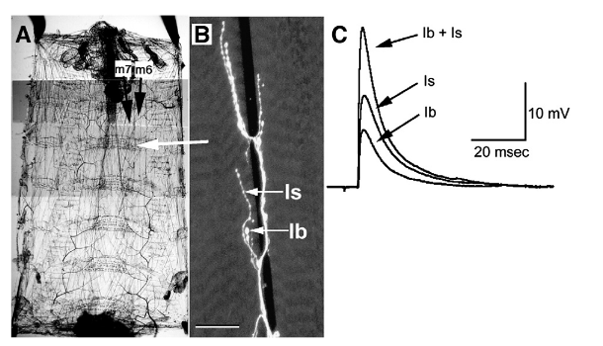
Neuromuscular matching with synaptic strength
Lee, Bhatt, Bhatt, Chung, and Cooper (2009) Comparative Biochemistry and Physiology

Slide 63
Hands on activities with living organisms
Collect data, graph data, interpret data, discuss the results

